Slide 1

Homicide over the past decade Project-4 Group-1 SMU Data Science Bootcamp
Sep-2023

Slide 2
Meet Our Team
Project Team Student Members :
Carlos Delarosa
Raj Agrawal
Ann Ly
John Banowsky
Faculty :
Alex Booth - Instructure
Sherhone Grant - TA
Sean Fleming - SSM

Slide 3
AGENDA
Introduction
Inspiration to select data
About Data
Analysis
Website
Data cleaning
Machine-learning
Tableau

Slide 4
Project Title & Description
Title - “Homicides over the past decade”
We have selected above as our Title / theme to perform the data analysis
PROJECT 4 - Our main purpose is to use a standard dataset and utilize various tools that we learn so far i.e. – machine learning, Tableau
Ability to connect to a file set
Ability to fetch data and organize them with various useable data frame
Perform supervised model / predictions
To use correlation and create various Bar, Donut, line charts using Tableau
Data Collection- The Washington Post collected data on more than 52,000 criminal homicides over the past decade in 50 of the largest American cities. The data included the location of the killing, whether an arrest was made and, in most cases, basic demographic information about each victim. Reporters received data in many formats, including paper, and worked for months to clean and standardize it, comparing homicide counts and aggregate closure rates with FBI data to ensure the records were as accurate as possible.

Slide 5
INSPIRATION
Why did you decide to use that topic? Inspiration, etc.
Carlos – My inspiration is to analyzing a homicides dataset to investigate how victim age influences arrest outcomes in cases
Raj – To learn more about homicides dataset and related investigation, and used acquired knowledge of the data science bootcamp for the data analysis. Eventually, participate in the volunteer program to help community to serve better.
Ann – I am interested in knowing more about the shared factors among all the homicide cases.
John – Homicides are never a good thing. Having a better understanding of which populations are affected will help us better address homicide to protect these demographics.

Slide 6
DATA
Homicides – Dataset from Kaggle https://www.kaggle.com/datasets/joebeachcapital/homicides
Population Data – Datasets from US Census
https://www.census.gov/data/datasets/time-series/demo/popest/intercensal-2000-2010-cities-and-towns.html
https://www.census.gov/programs-surveys/popest/technical-documentation/research/evaluation-estimates/2020-evaluation-estimates/2010s-cities-and-towns-total.html

Slide 7
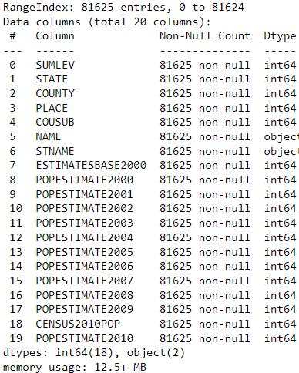
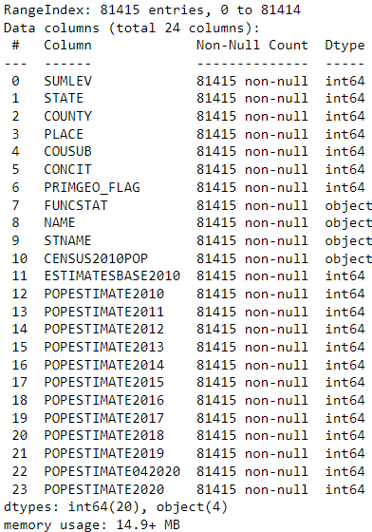
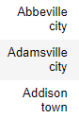
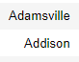
CENSUS DATA CLEANING
SubEst2010.csv SubEst2020.csv all_pop_data.csv
Dropped 2000-2006 and 2018-2020
Changed STNAME (state name) from full name to 2-letter abbreviation
Edited cities in the NAME column to match the 50 cities from the homicide_data.csv
Merged the two files together using City and State.

Slide 8
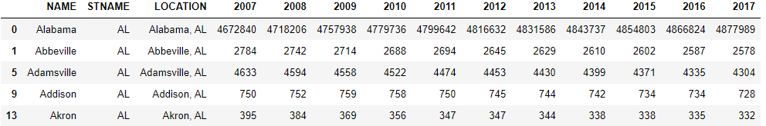
CENSUS DATA CLEANING

Slide 9
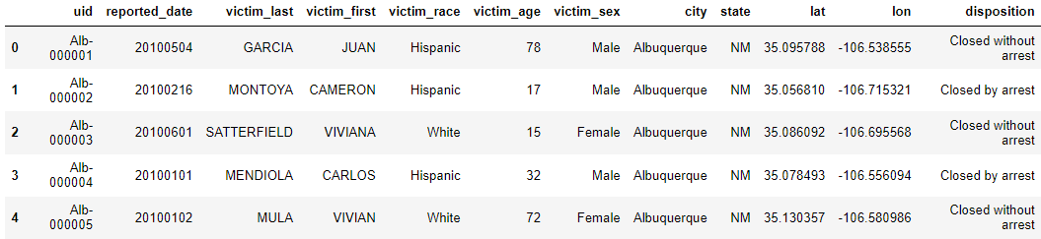
DATA CLEANING for MACHINE LEARNING
homicide_data.csv
Fixed spelling and typing errors in specific instances.
Dropped victim_last and victim_first
Dropped data that did not have full demographic information
Changed dispositon to a binary “Arrest Made” or “No Arrest”
Split “reported_date” into year, month, day of week, and season.
Merged city and state columns into LCOATION
Dallas, TX, Phoenix, AZ,
Kansas City, MO, where dropped entirely.
Original Homicide Count: 52179
Count of Usable Data: 47478

Slide 10
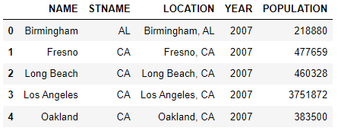
DATA CLEANING for MACHINE LEARNING
Merged “homicide_data.csv” and “all_pop_data.csv”
Filtered the population data to the 50 cities in homicide data.
Used a melt function to return the populations for each city by year.
Merged on LOCATION
Saved as a new csv file “ml_clean_homicide_data.csv”

Slide 11
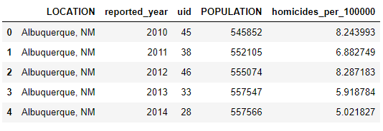
DATA CLEANING for TABLEAU
Same
Fixed spelling and typing errors in specific instances.
Dropped victim_last and victim_first
Changed dispositon to a binary “Arrest Made” or “No Arrest”
Split “reported_date” into year, month, day of week, and season.
Merged city and state columns into LCOATION
Different
Did not drop because of incomplete demographic information
Kept Dallas, TX, Phoenix, AZ, and Kansas City, MO
Saved as a new csv file “tbl_no_drop_homicide_data.csv”
Used the population and homicides per year to calculate homicides per 100,000 population
Saved as a new csv file “tbl_homicide_count_per_100000.csv”

Slide 12
PLANNING
Color palette
Mixed selection – light / gray
Expected Outcome - of the data analysis
What are at least THREE research questions you want to explore/answer in this data source?
How race / age data summaries
Homicide over a period of time
Census data merge with homicide data to see population / demographic
Additional Research Questions to Answer
Per 100,000 rate of homicides

Slide 13
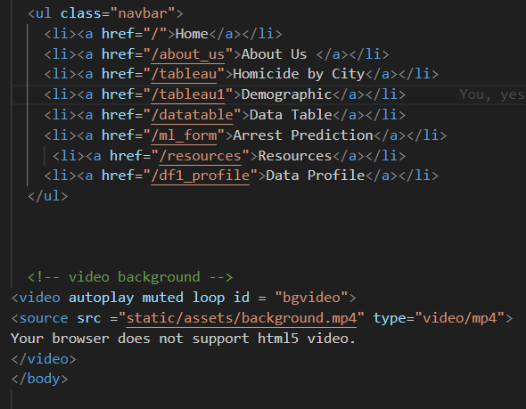

WEBSITE DEVELOPMENT
Capturing the audience attention with a video background
Respecting the Topic with the tones of color

Slide 14
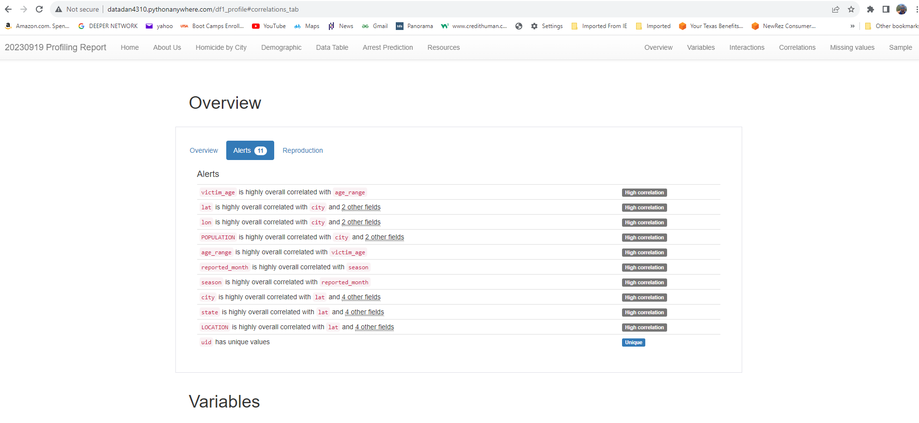
WEBSITE DEVELOPMENT
Embedding Ydata for dataset profiling
Overview of our dataset

Slide 15
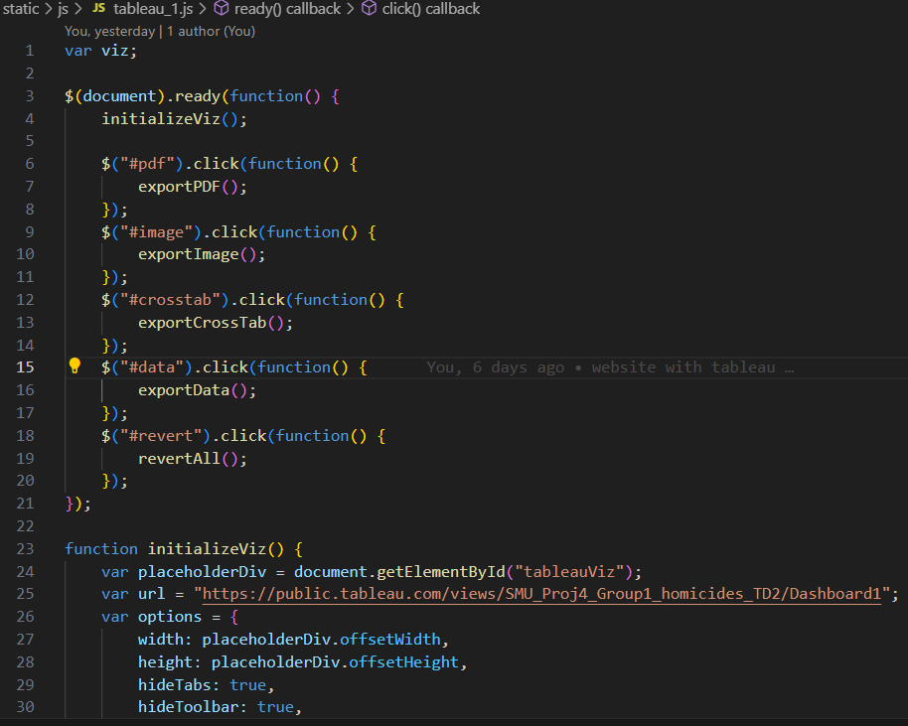
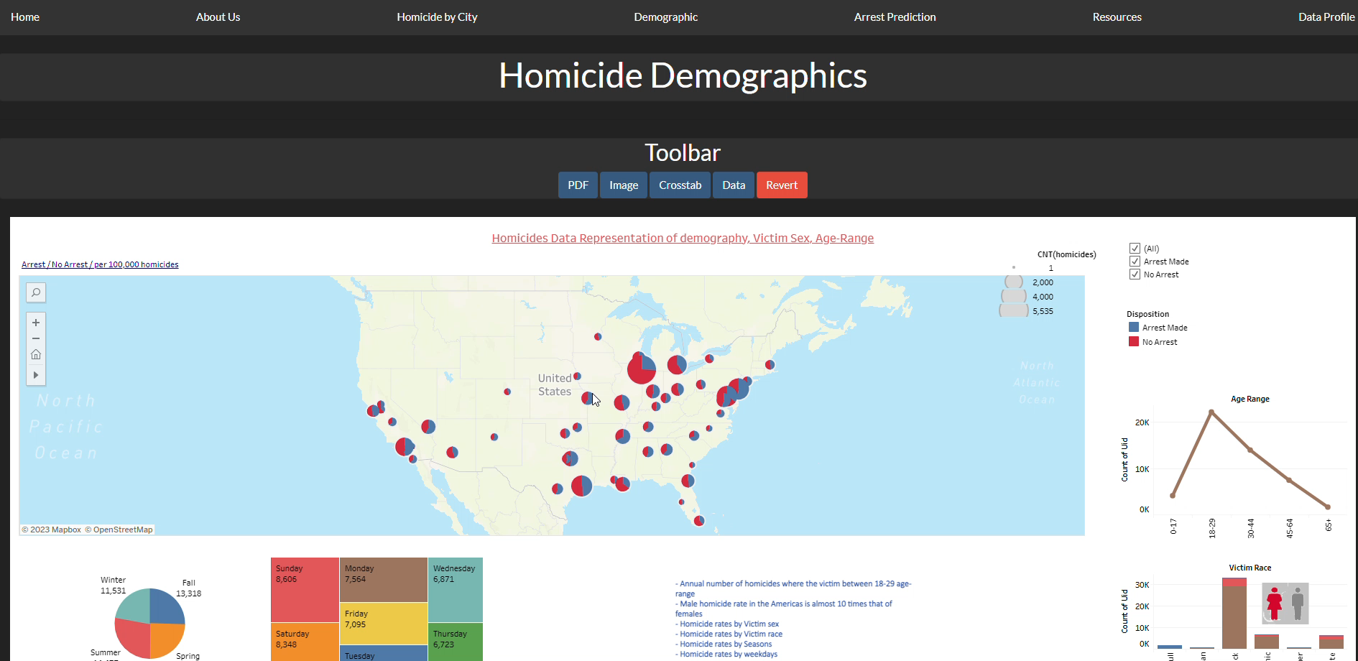
WEBSITE DEVELOPMENT
Calling API
Tableau page

Slide 16
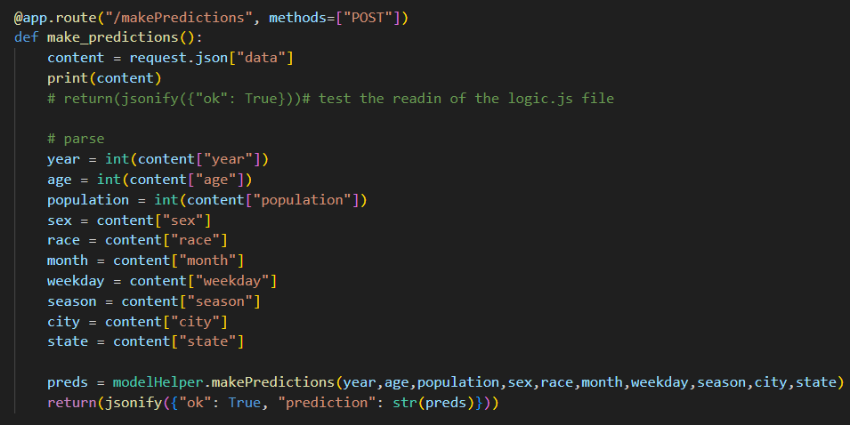
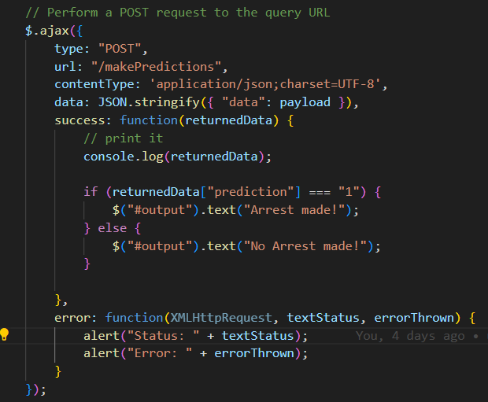
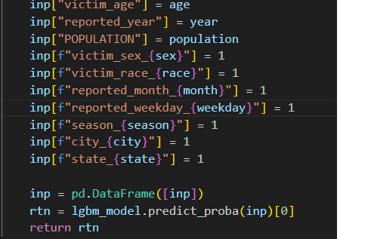
WEBSITE DEVELOPMENT
Prediction form Challenges

Slide 17
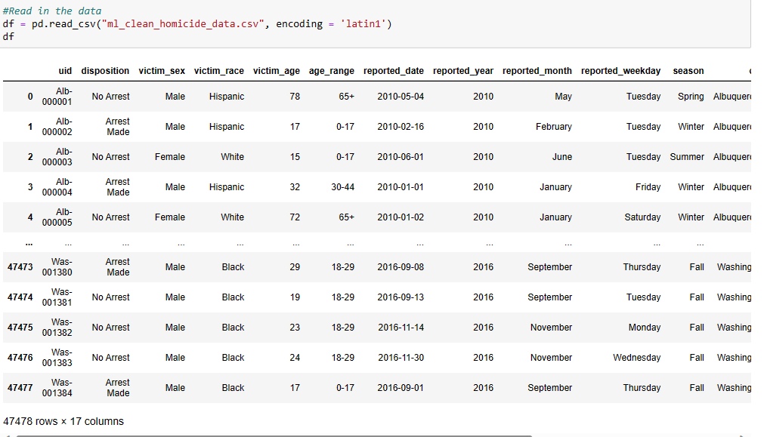
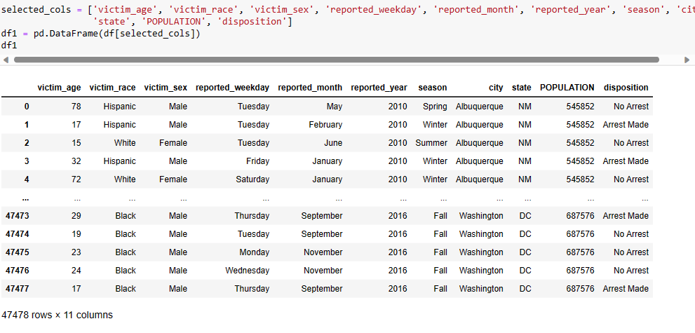
MACHINE LEARNING
Read in the CSV file for machine learning
Select columns from the DF that will be use for machine learning and put them in a DataFrame

Slide 18
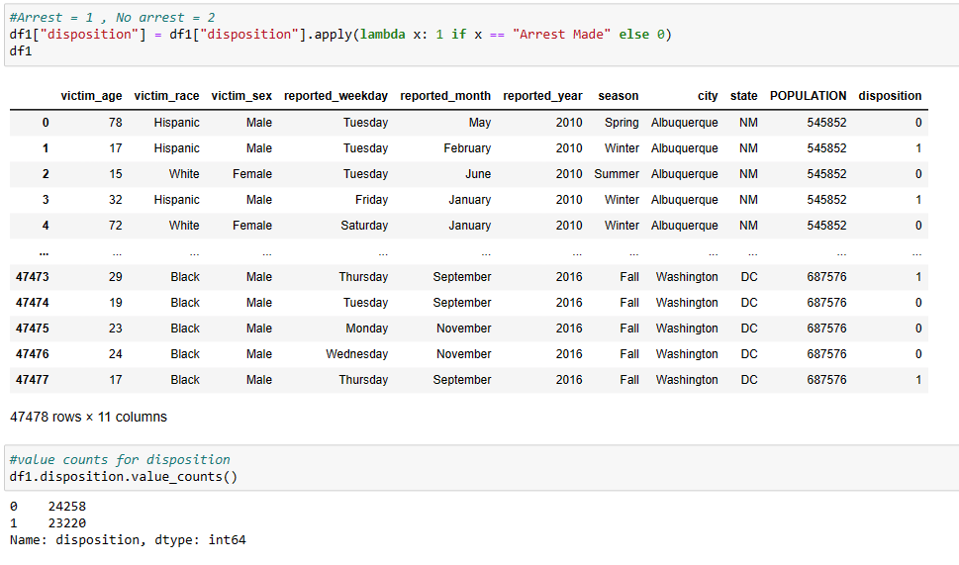
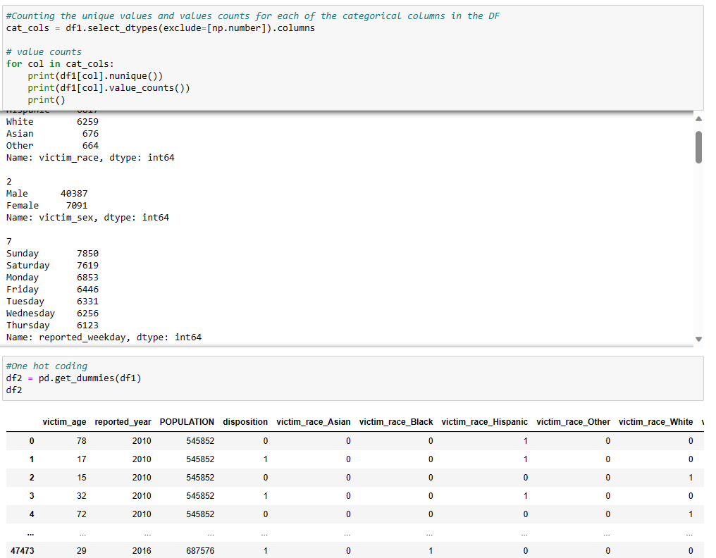
MACHINE LEARNING
"We have designated 'disposition' as the target variable for our machine learning task. Consequently, we transformed the values in this column into a binary format, where 1 represents 'arrest made' and 0 signifies 'no arrest'."
Count the unique values of each categorical column in the DF, followed by applying One Hot Coding to these columns.

Slide 19
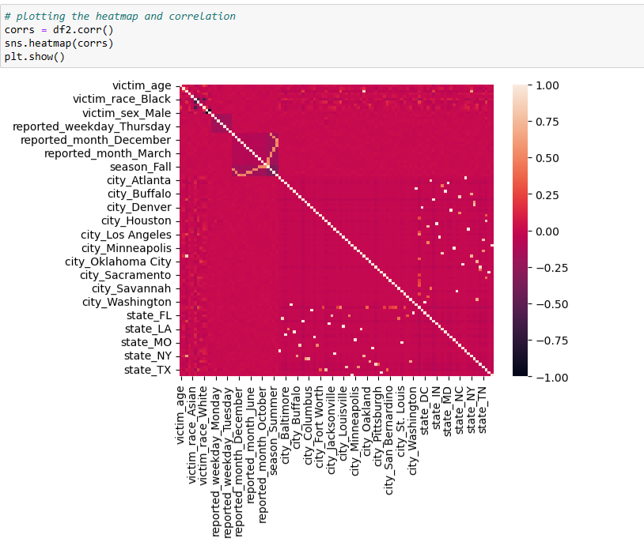
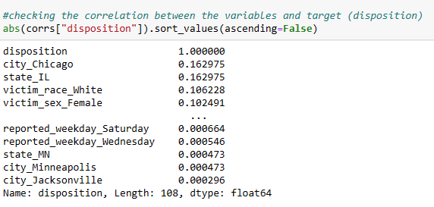
MACHINE LEARNING
The correlation between disposition and all other variables:
Chicago: 16%
IL: 16%
Victim Race: white: 11%
Victim_sex: Female: 10%

Slide 20
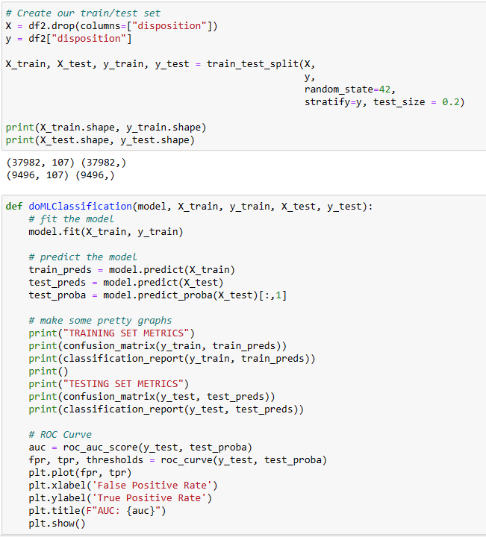
MACHINE LEARNING
- Set “disposition” as the target variable: Y
Create out train/test set using train_test_split function
Fit the model

Slide 21
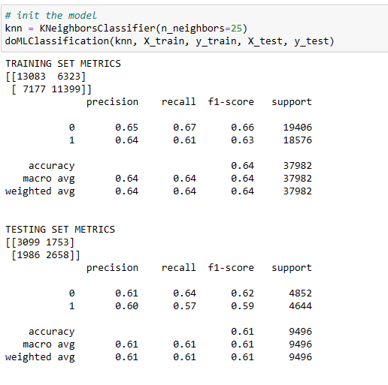
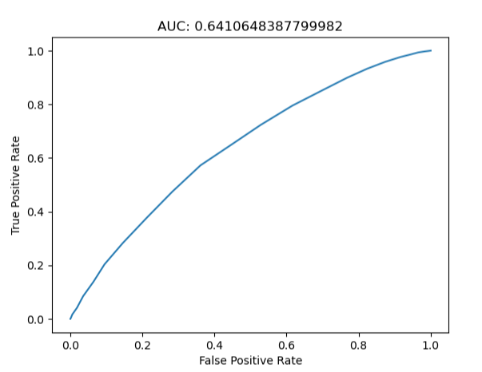
MACHINE LEARNING
KNN Model:
Precision
Arrest(1): 60% in testing vs. 65% in training model
No Arrest(0): 61 % vs. 65% in training model
Recall:
Arrest: 57% in testing vs. 61% in training model
No Arrest: 64% in testing vs. 67% in training model
F1: Arrest: 59% in testing vs. 63% in training model
No Arrest: 62% in testing vs. 66% in training model
Accuracy: 61% for testing model and 64% for training set.
AUC score is 64% ---- the model is performing slightly better than random guessing, but it’s still not providing a strong level of discrimination between all the classes.

Slide 22
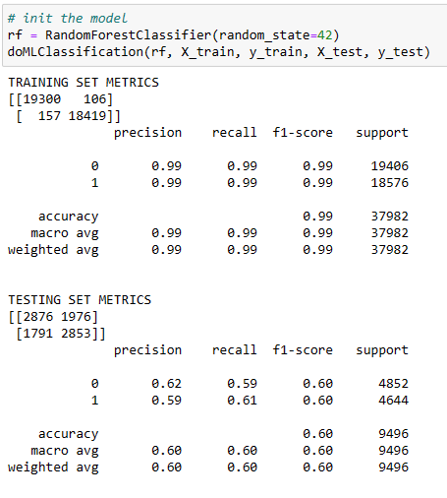
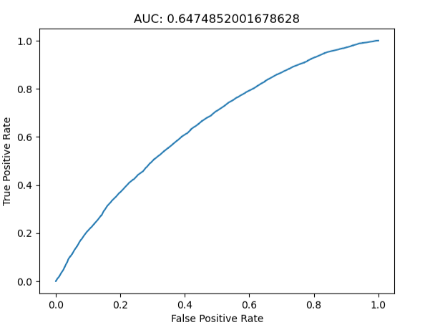
MACHINE LEARNING
Data indicating overfitting for the training set data metrics.
Testing model’s performance is very low, accuracy score of only 60%
AUC 64% -- still not a good model for classification and predicting outcome.

Slide 23
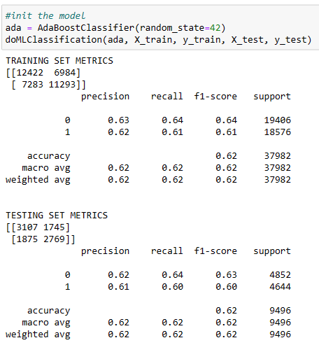
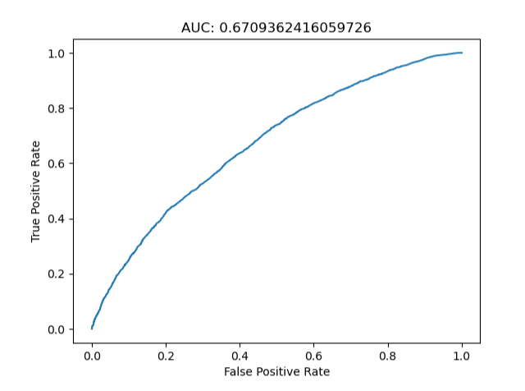
MACHINE LEARNING
ADA Model:
Precision
Arrest(1): 62% in testing vs. 61% in training model
No Arrest(0): 62 % vs. 63% in training model
Recall:
Arrest: 60% in testing vs. 61% in training model
No Arrest: 64% in testing vs. 64% in training model
F1: Arrest: 60% in testing vs. 61% in training model
No Arrest: 63% in testing vs. 64% in training model
Accuracy: 62% for both testing and training models
The AUC score is 67% ---- the model performs significantly better than random guessing. This suggests that the model has some effectiveness in making predictions.

Slide 24
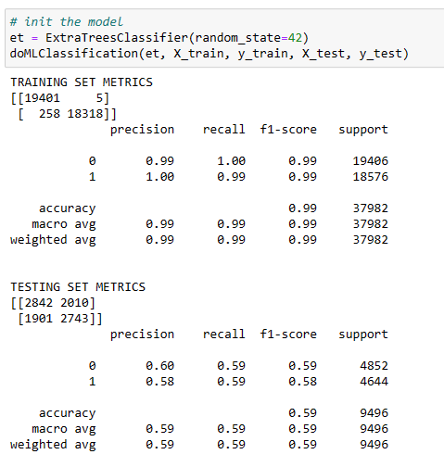
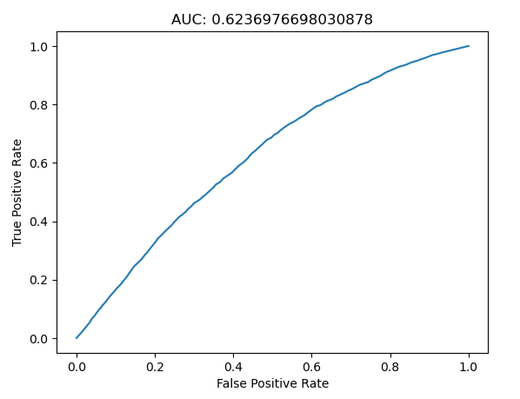
MACHINE LEARNING
ExtraTrees Model:
Training model suggest overfitting
Testing model score are low in precision, recall, f1 and accuracy.
AUC of only 62%.
Not a good model.

Slide 25
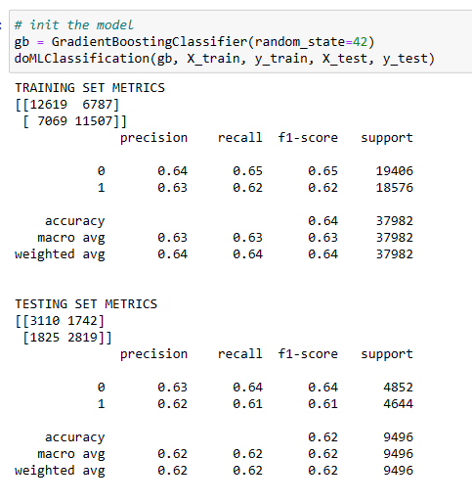
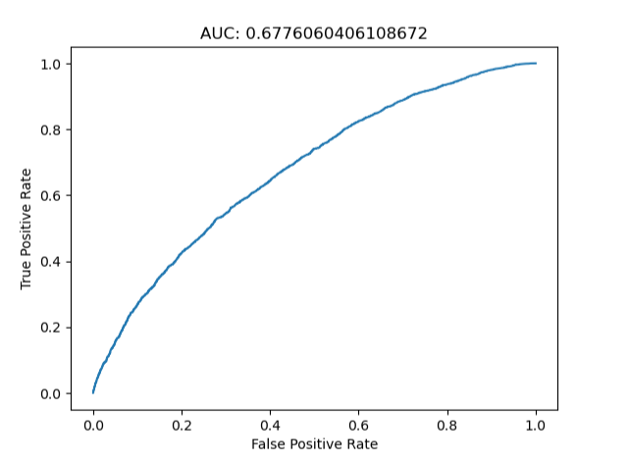
MACHINE LEARNING
GradientBoostingClassifier Model:
Precision
Arrest(1): 62% in testing vs. 63% in training model
No Arrest(0): 63% in both models
Recall:
Arrest: 60% in testing vs. 61% in training model
No Arrest: 64% in testing vs. 64% in training model
F1: Arrest: 61% in testing vs. 62% in training model
No Arrest: 63% in testing vs. 64% in training model
Accuracy: 62% for testing and 64% training models
The AUC score is 68% ---- the model performs significantly better than random guessing. This suggests that the model is effectiveness in making predictions.

Slide 26
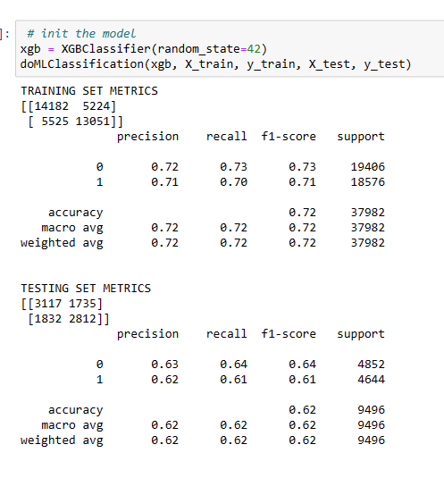
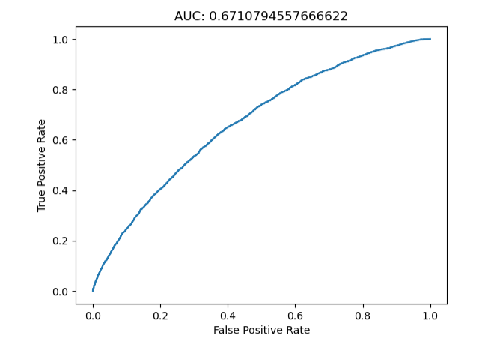
MACHINE LEARNING
XGB
Precision
Arrest(1): 62% in testing vs. 71% in training model
No Arrest(0): 63 % vs. 72% in training model
Recall:
Arrest: 61% in testing vs. 70% in training model
No Arrest: 64% in testing vs. 73% in training model
F1: Arrest: 61% in testing vs. 71% in training model
No Arrest: 64% in testing vs. 71% in training model
Accuracy: 62% for testing and 72% for training models
The AUC score is 67% ---- the model performs significantly better than random guessing. This suggests that the model has some effectiveness in making predictions.

Slide 27
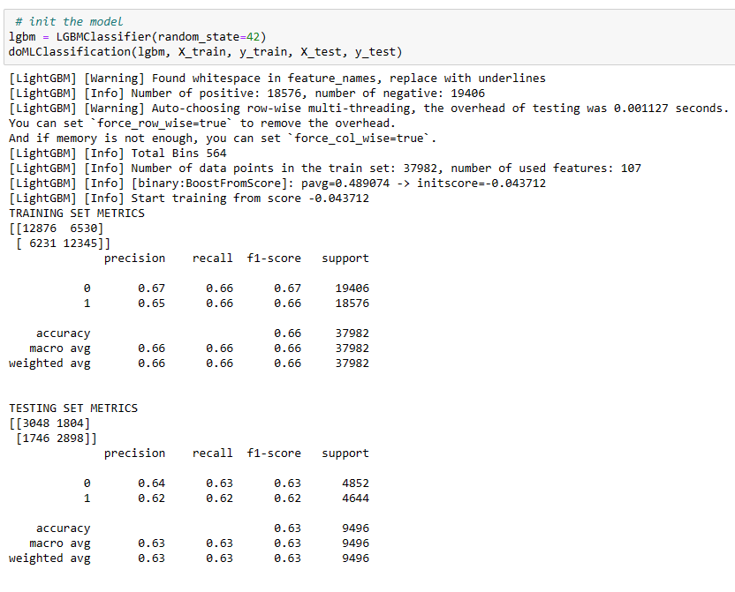
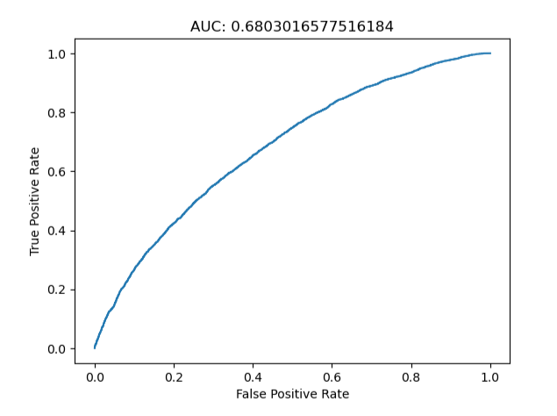
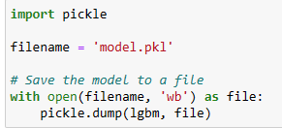
MACHINE LEARNING
LGBM Classifier:
Precision
Arrest(1): 62% in testing vs. 65% in training model
No Arrest(0): 64 % vs. 67% in training model
Recall:
Arrest: 62% in testing vs. 66% in training model
No Arrest: 63% in testing vs. 66% in training model
F1: Arrest: 62% in testing vs. 66% in training model
No Arrest: 63% in testing vs. 67% in training model
Accuracy: 63% for testing and 66% for training models
The AUC score is 68% ---- the model performs significantly better than random guessing. This suggests that the model has some effectiveness in making predictions.
We picked LGBM to do hyperparameter tuning and K fold cross-validation.
We also need to deploy this model for the prediction tab on our website, so we saved the model as a pickle file.

Slide 28
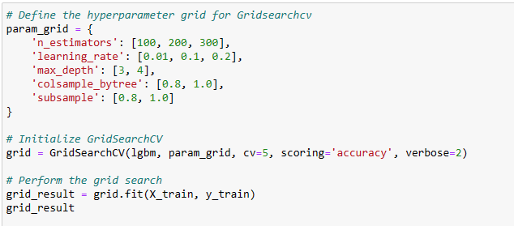
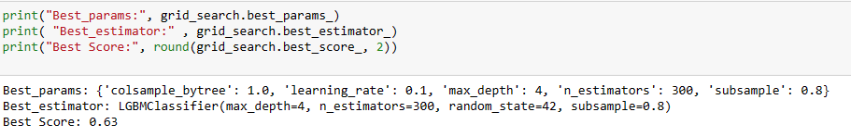
HYPER PARAMETER TUNING: GRIDSEARCHCV
We used GridSearchCV to perform hyper parameter tuning on LGBM model. The accuracy turned out to be 63%, same as the original model.

Slide 29
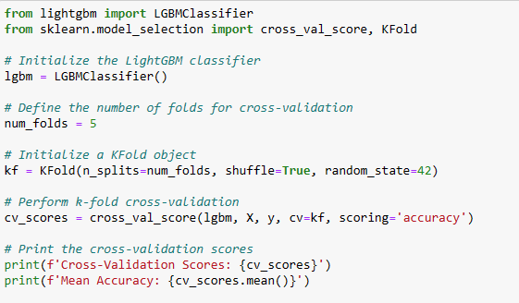
MACHINE LEARNING – CROSS VALIDATION, KFOLD
We use Cross validation, and Kfold to calculate the average accuracy of the LGBM classifier, the result is still 63%.

Slide 30
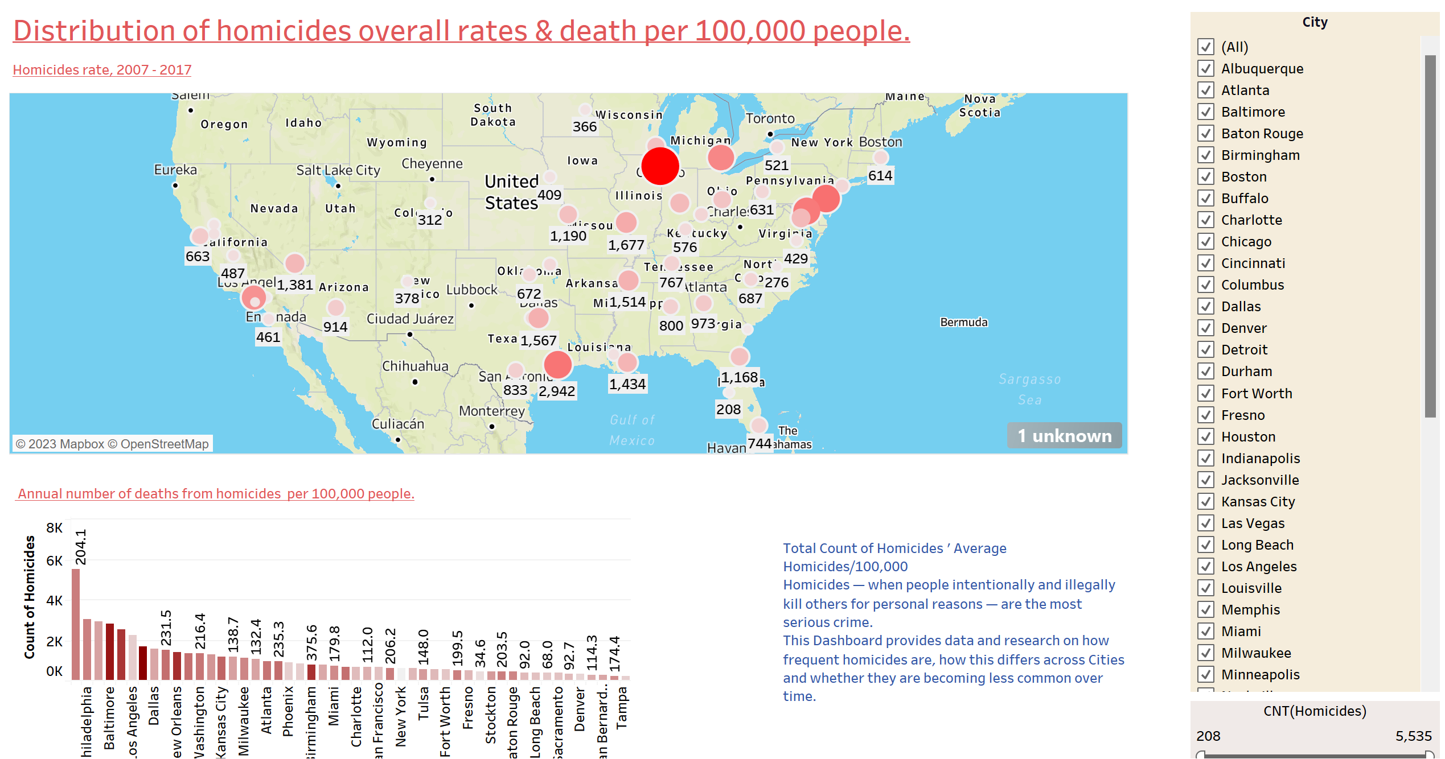
DATA VISULASIZATION - TABLEAU
Tableau dashboard – main page explains about distributions of the homicides across US cities. The dashboard has filters based on Cities & a range of count of homicides

Slide 31
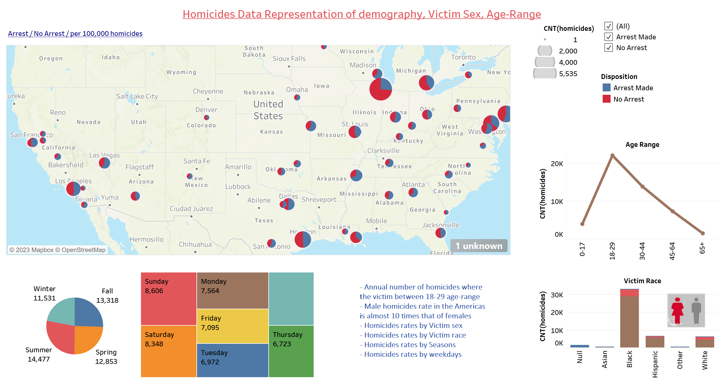
DATA VISULASIZATION - TABLEAU
Tableau dashboard – second page explains demography wise distributions of the homicides across US cities. The dashboard has filters based on “Arrest” “no arrest” & a range of count of homicides

Slide 32

Q&A
References
xxxxxxxxxxxxxxxxxxxxxxxxxxxxxxxxxx

